Slide 1

Hostel Room Allocation System
Presented by Group 6

Slide 2

TODAY'S TOPICS
Introduction
Objective
Our Services
Implementation
Sample Pages
Demo
Conclusion
Presentation
Outline

Slide 3

Introduction
HOSTEL ROOM ALLOCATION SYSTEM
A software that allows automation of currently existing hostel room allocation process, while not compromising on the choices of the student's for their roommates and hostels.

Slide 4

Objective
Computerisation
Data Consistency
User Friendly
Make the currently existing process of the room allocation completely automated.
No loss of data and reducing data redundancy to the possible extent.
A responsive web page with a proper front end and that is easier to interact with.

Slide 5

Multiple Admins
Send and Accepting requests
Easy Record Keeping
Transparency in the system
Our Services
Easy student interaction

Slide 6
Administrator Module
Allot different students in different hostels.
Vacate all the students from the hostel
Appoint new admins(only by the main admin)
Add new hostels and assign admins to it.(only by the main admin).
Post feed to the students.
Implementation

Slide 7
2. User Module
Student can choose their roommates
Edit their profile.
Allows students to send and accept requests and get notified for the same.
Can post complaints to the admin and check the status of the complaint.
Can see the feed posted by the admin.
Implementation

Slide 8
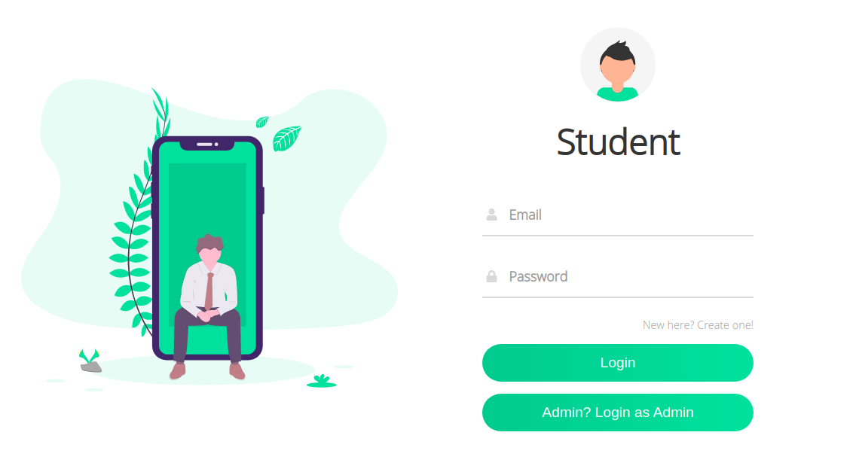
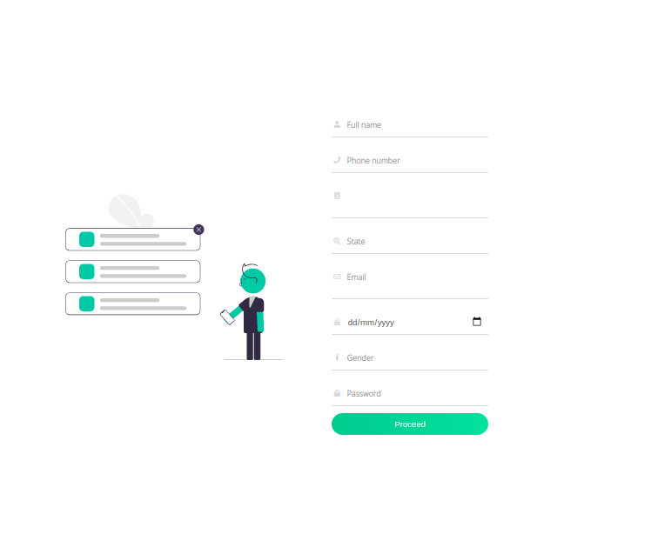

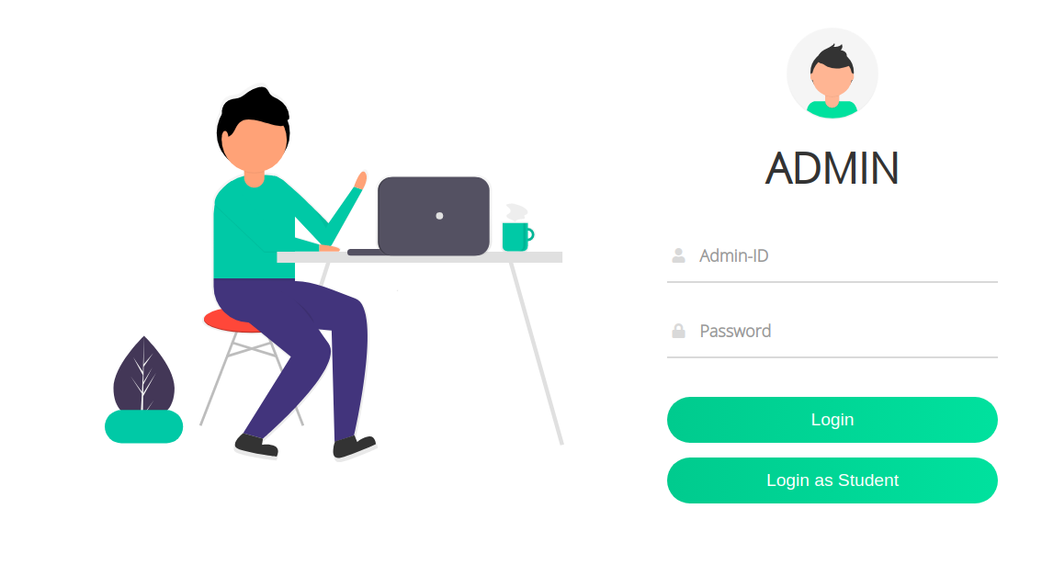
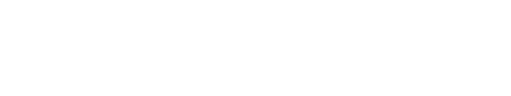
Sample Designs
Web pages for the users logging in.

Slide 9
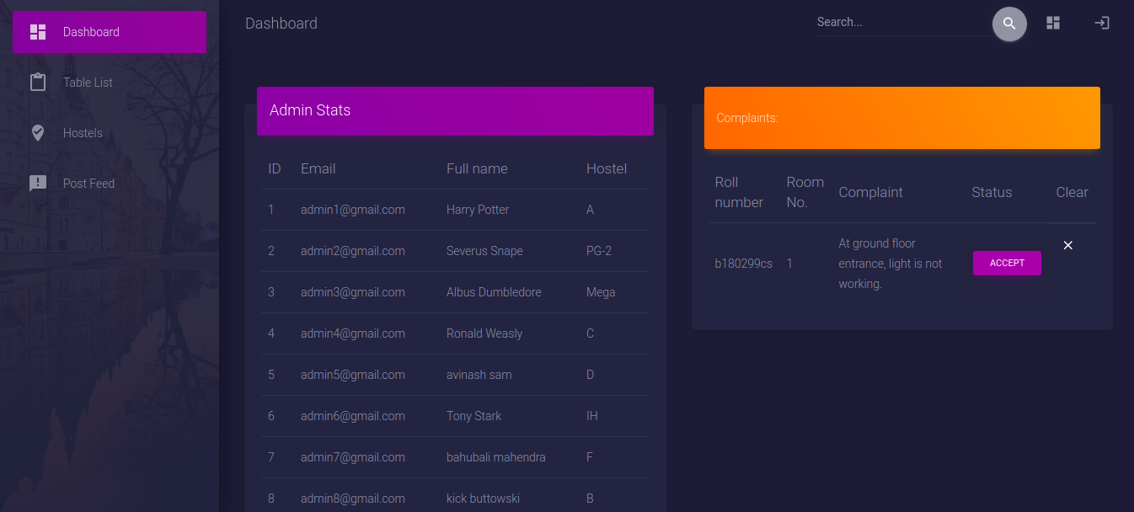
Presentations are communication tools that can be used as demonstrations, lectures, speeches, reports, and more. Most of the time, they’re presented before an audience.
Admin Dashboard

Slide 10
Demo

Slide 11
Reduced the strain of allocating rooms.
Provided the facility of sending room requests to peers.
Instant Complaint box to post student’s issues to hostel administration.
Replaced the use of notice-boards since admins can send updates and feed to all students.
Conclusion

Slide 12
Mohith Kumar Thummaluru
Avinash Samudrala
Rahul Kumawat
Tushar Kumar Patni
Ritik Goutham
Thanks
GROUP 6

